Slide 1
A Coram Company

Slide 2
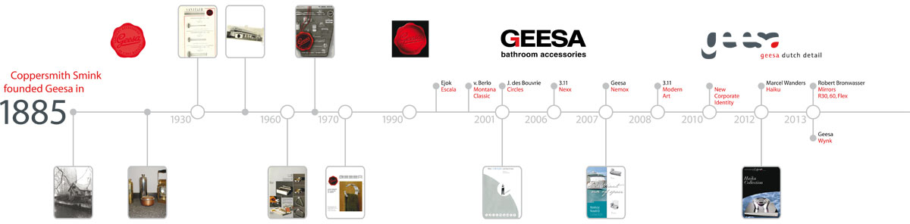
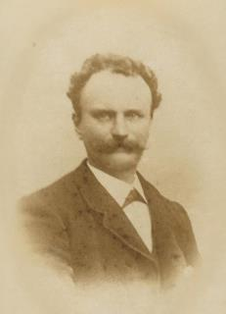
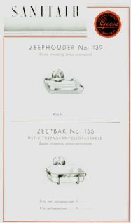
Geesa, since 1885
Albert Smink

Slide 3
The Coram Holding
Coram Holding
Geesa BV
Bathrooms Acc.
Tiger
DIY Accessories.
Sealskin
Shower Enclosures
DPI
Injection Moulding
Impey
Wetroom specialist
Holding revenue: 140 Mio. EUR
Company revenue: Over 10 Mio. EUR
Approx. 700,000 articles sold per year
Geesa employees: 49
Export share: 65%
Number of markets: 70 countries

Slide 4
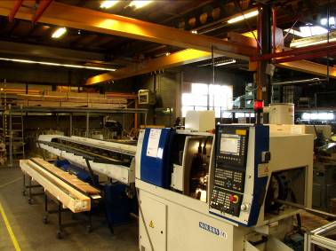
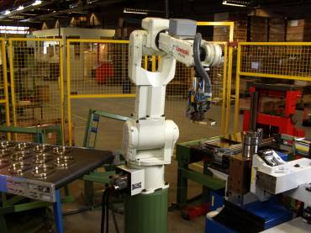
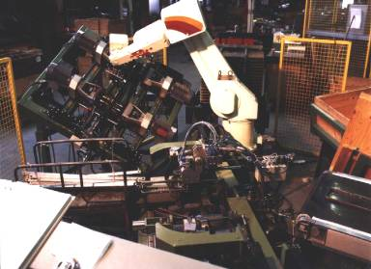
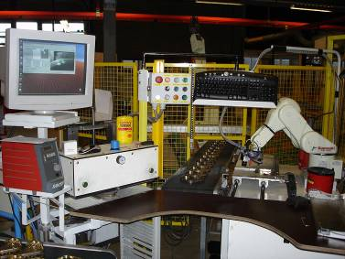
Geesa Factory

Slide 5


Involvement matters
Long-term relations with partners. Very low staff turnover. (average of 17 years at Geesa) Social sponsorships (Ronald McDonalds foundation)
Involvement matters

Slide 6
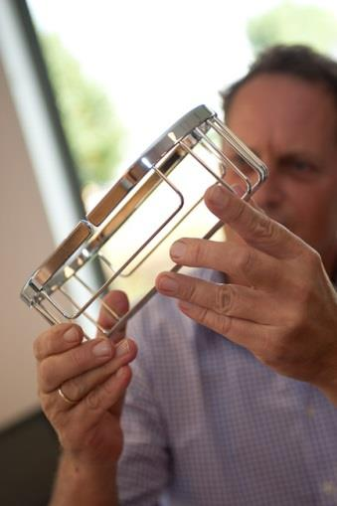
Details matter
Fixing material included in every product. Ease in cleaning and mounting. Maintenance instructions for all products. Uniform packaging solution. Excellent after sales organization 130 years of experience Customization
Details matter
DETAILS MATTER

Slide 7
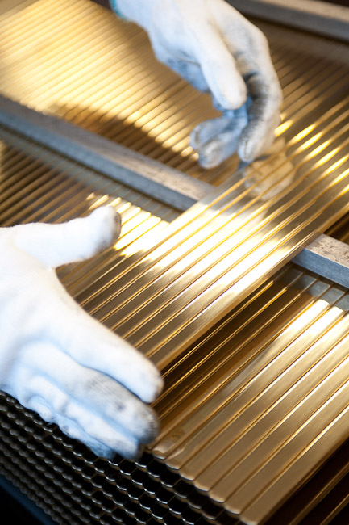
Quality matters
12 year guarantee on most products In-house experienced Quality Department Implementation of Quality Control Systems for our sourced items / parts Extensive product and material testing All in-coming components and items go through quality check. ISO 9001 : 2008
Quality matters
Notes:
0,7 % quality costs as a % of turnover

Slide 8
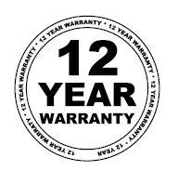

Slide 9
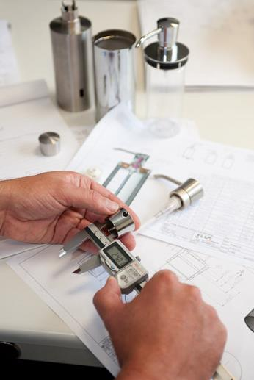
R&D matters
All engineering in Holland Choice of quality materials Developments in new materials and techniques Detailed drawings, 2D and 3D Strength analysis Molds, jigs and contra-jigs High precision gluing instead of welding
R&D matters

Slide 10
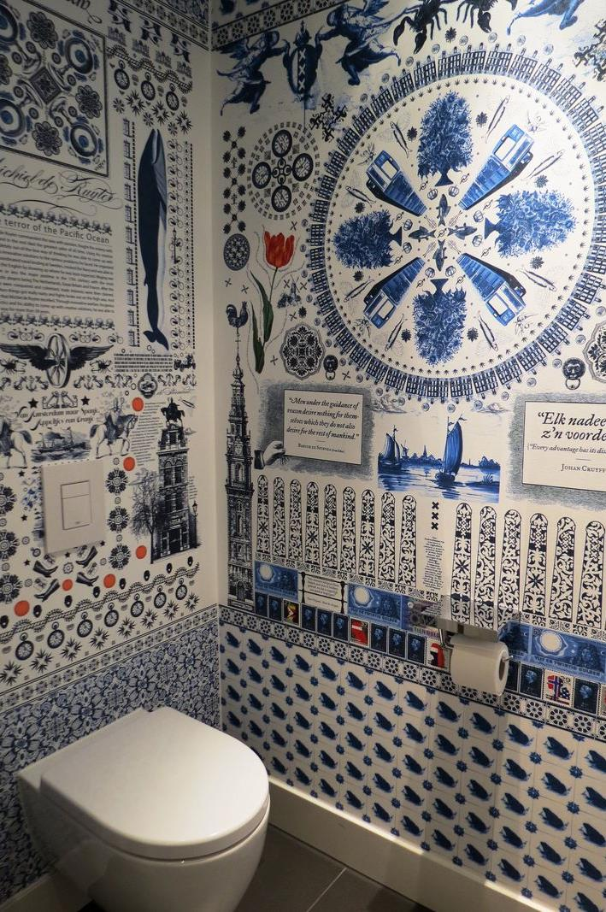
Design matters
Cooperation with top designers! Design awards Trendy but timeless Uniqueness and originality in design Ease of use Easy to clean Easy to install Ergonomical design
Design matters
Notes:
ALSO MILAN 2 WEEKS AGO
THE PICTURE IS MADE BY A DUTCH COMPANY WHICH PRODUCES HUGE PRINTS, LARGER THAN LIFE

Slide 11
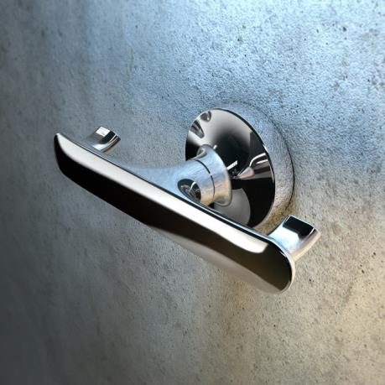


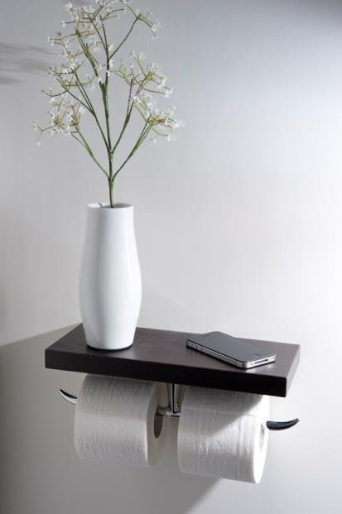
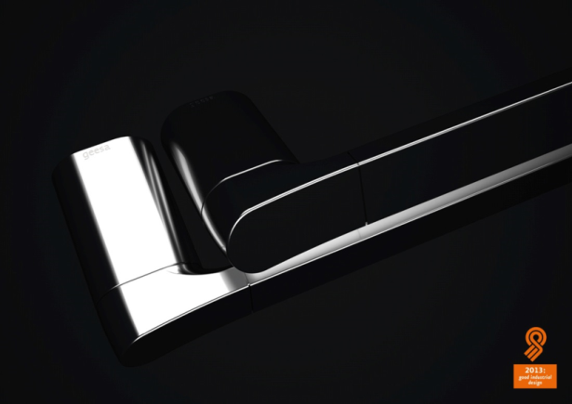

Design Awards

Slide 12
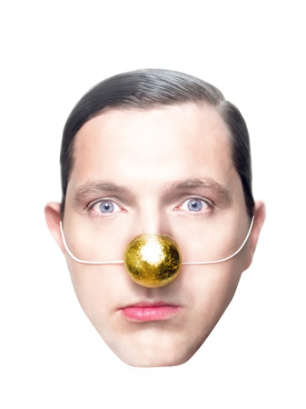
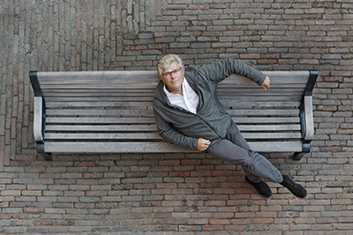
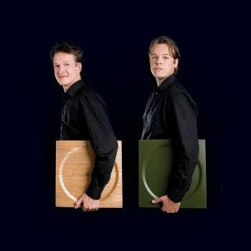
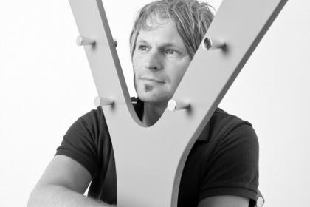
Local designers
NPK | Design (Eng/Dsgn)
Marcel Wanders
3.11 (MA)
Robert Bronwasser

Slide 13







International designers
Tillberg Design AB

Slide 14
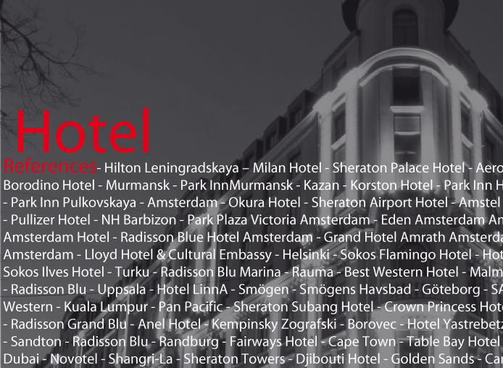
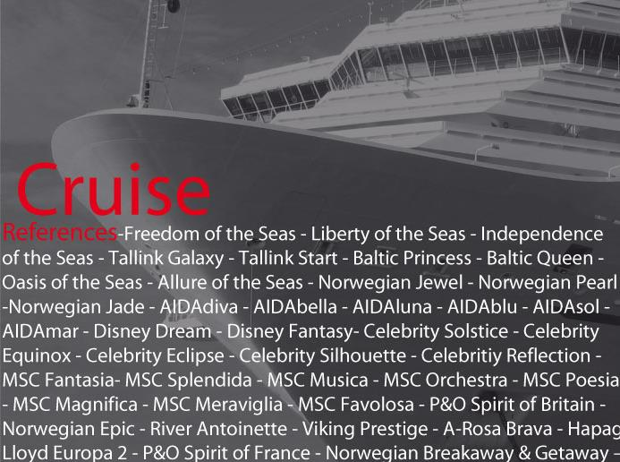
Customers matter
Retail Hotel & Cruise industry Housing projects Preferred supplier of several hotel groups (Rezidor Hotel Group, Hilton International, IHG International) Customized production (MOQ >250) Flexible organisation Service minded
Customers matter

Slide 15
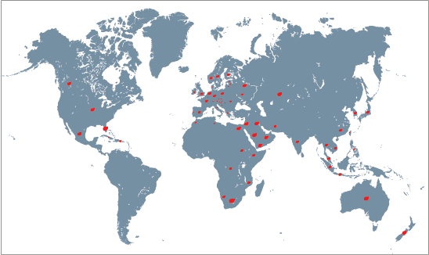
Worldwide distribution

Slide 16
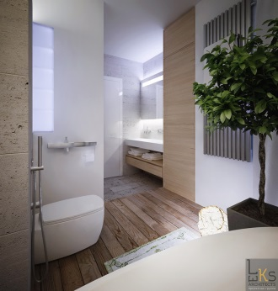

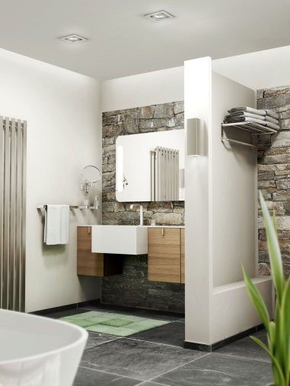
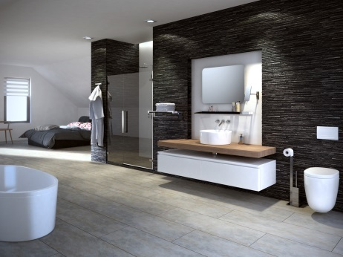
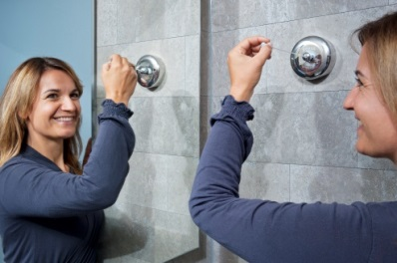
Segmentation
Standard/Hotel
Thessa
Bloq
Luna
Basket
Projects
Wynk
Nexx
Nemox
Nelio
Tone Chrome
Projects
Modern Art
Tone Gold
Haiku
Hairdryer
Cosmetic mirrors
Public Area
Projects
Projects
Retail
Wholesale
Basic
Retail
Wholesale
Middle
High end
Retail
Wholesale
Retail
Wholesale
Notes:
Marcel Wanders is 100 % Dutch Design
Project started end of 2009
MW studio did the basic designs
GBO & Geesa did the technical development/details
Next month will be crucial / trip to China
December we will know if products are available at the ISH (lost 3 months during the development process)

Slide 17
Price range collections

Slide 18
Geesa Coating standards
Brass material ➔ 14,8 µm nickel + 0,2 µm chrome=15,0
Zamac ➔ 15 -20 µm copper + 10 - 12 µm nickel + 0,25 µm chrome = approx 25
Stainless steel ➔ 15 - 20 µm nickel + 0,2 µm chrome = 15,2 – 20,2

Slide 19

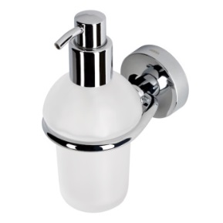
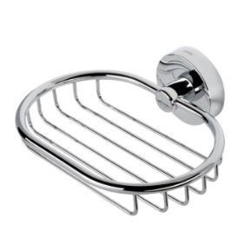
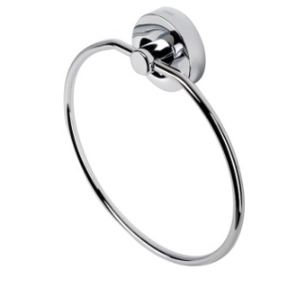
Luna
Timeless design
12 years guarantee
Chrome nickel plated brass, ABS wall cover and ZAMAC wall plate
Available in Ø20 and Ø24mm tube
3 point easy fixation, plugs and screws incl.
Produced in Amersfoort
CoO: made in Holland
Wide range of items and therefore perfect for projects (close to 40 items products)

Slide 20
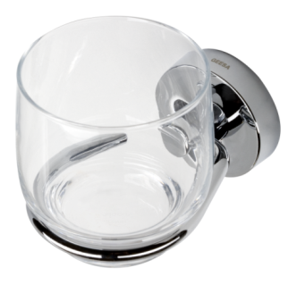
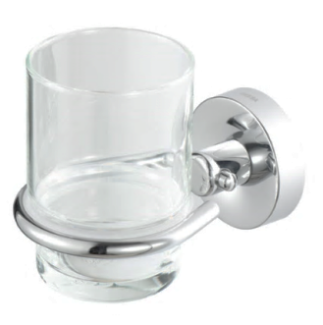
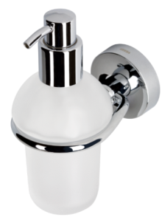
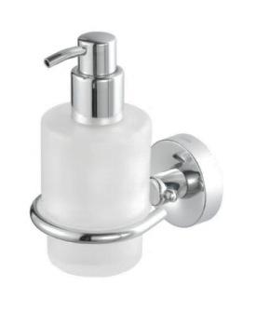
Adjustments Luna collection
Discontinued as of April 1st 2016:
  915510-06, 915555
  Above items can still be produced at quantities of > 250 pcs.
New additions:
  New glass with transparant PP insert in the holder
  New soap dispenser glass with transparant PP insert in the holder
  Available 05/2016 + no price increase
Old
New
Old
New

Slide 21
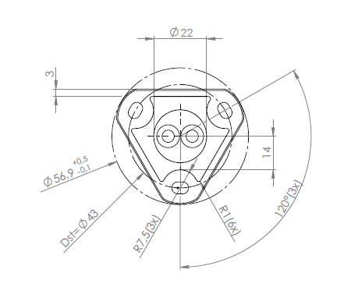
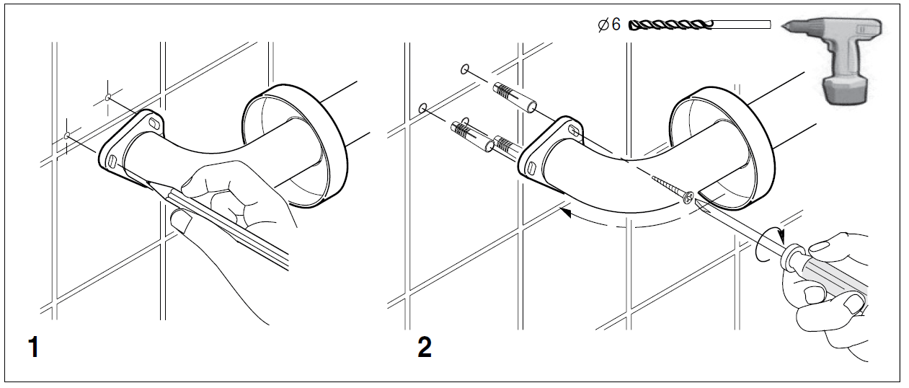
Fixation Luna

Slide 22
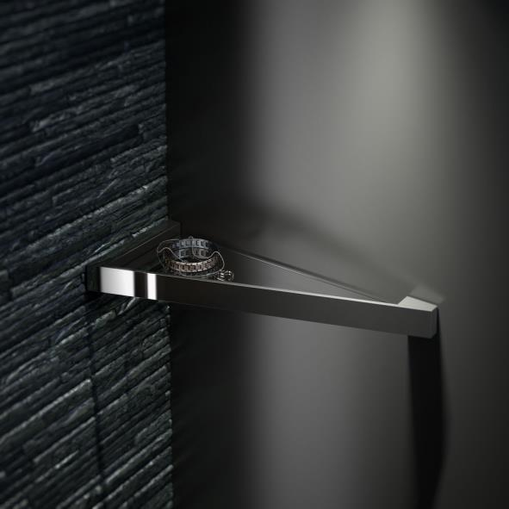
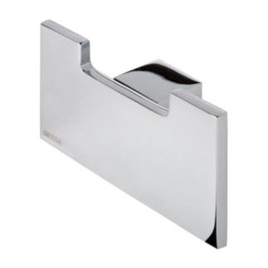
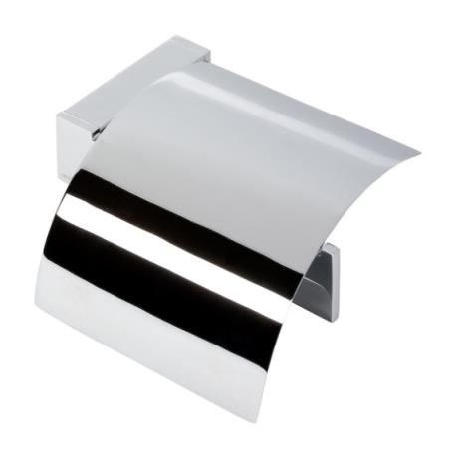
Modern Art
Modern and elegant design
12 years guarantee
Chrome plated brass and zamac
High end collection
Assembly Amersfoort
CoO: Made in Holland
2 point easy fixation
Anti slip grab rail

Slide 23
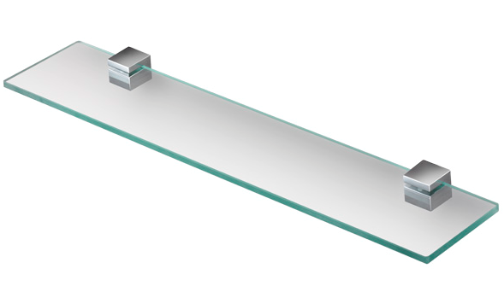
Adjustments Modern Art collection
Discontinued as of April 1st 2016:
  913501-02-80, 913501-02-100, 913507-02-100, 913533-02, 913533-06, 913501-02, 913511-02
  Above model can still be produced at quantities of > 250 pcs.
New additions:
  New item: 913549-02 (shelf holder 60 cm)
  Improved soap dispensers (200ml)
913549-02

Slide 24
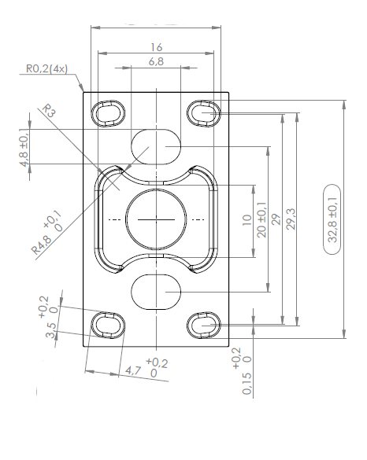
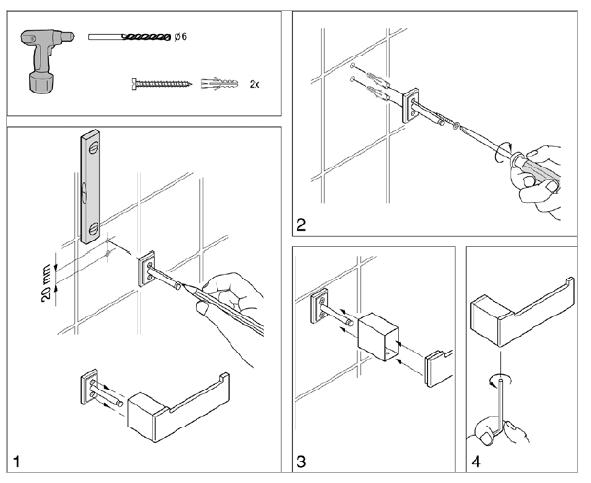
Fixation Modern Art

Slide 25
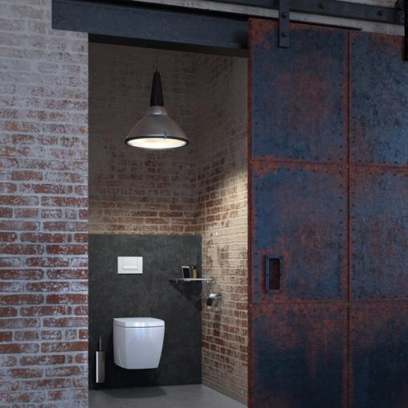
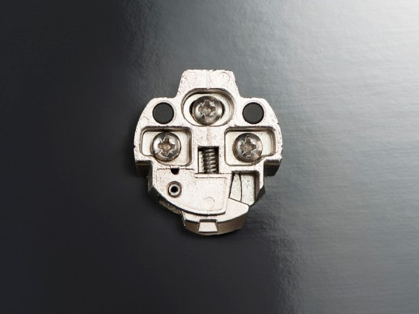
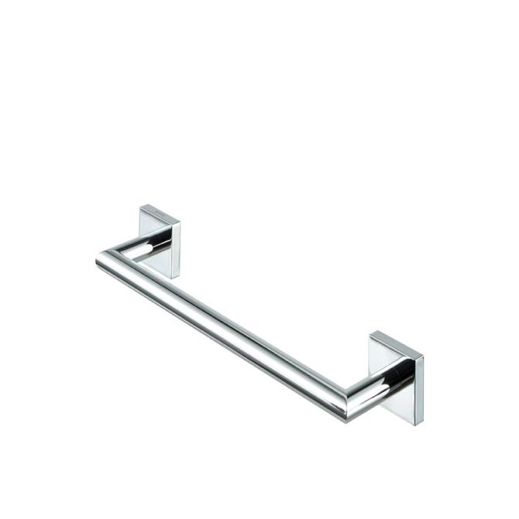
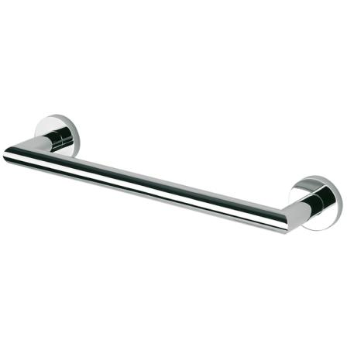
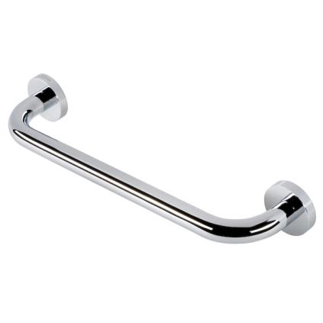
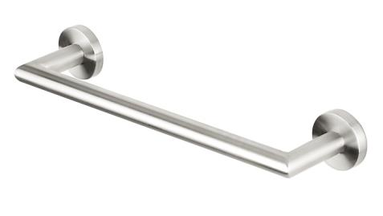
Nemox, Nelio
Minimalistic design
12 years guarantee/5 year (stainless steel)
Chrome plated stainless steel (304) and zamac
Popular broad project range, many variations possible, interchangeble parts
2/4 point easy fixation + plugs and screws
Assembly Amersfoort
CoO: Made in Holland
5 different versions (Chrome, Stainless steel, Nautiq, Nelio and Click)

Slide 26
Adjustments Nemox/Nelio collection
Discontinued as of April 1st 2016:
  916533-02/06, 916537-02, 916571-02
  Above model can still be produced at quantities of > 250 pcs.
New additions:
  New item: 916519-02 (one arm towel holder, 380mm)
  New added items: 916546-02+916801-02 ➔ shelves 58cm
  Improved soap dispensers (200ml & 250ml)

Slide 27
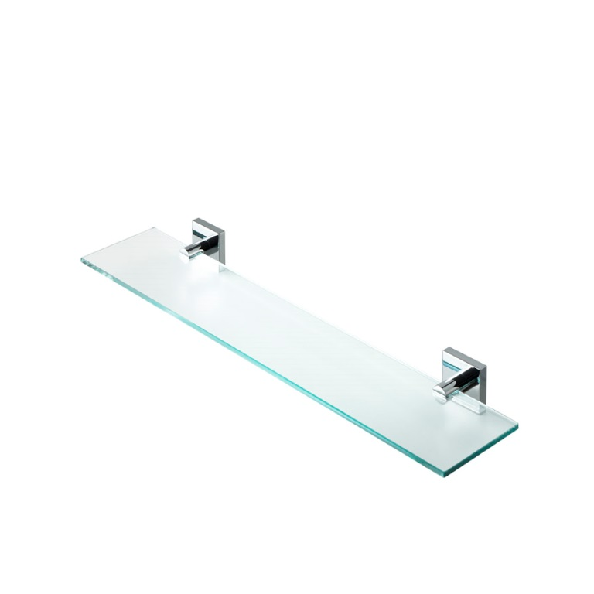
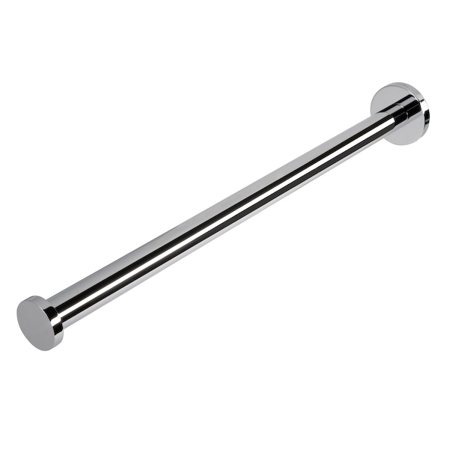
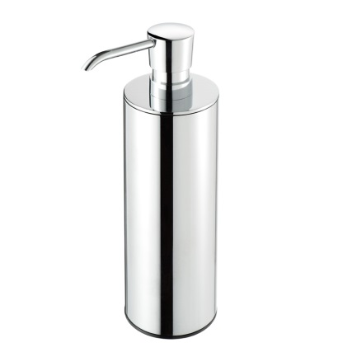


Recently added Nemox/Nelio items
916519-02
916801-02
916516-02-250
916546-02
916527-02

Slide 28


Fixation Nemox, Nelio

Slide 29




Wynk
Robust minimalistic, design for a competitive price
12 years guarantee
Chrome plated zamac, and stainless steel (304)
2 point easy fixation, screws and plugs incl.
Good industrial design award 2013

Slide 30



Fixation Wynk
Small wall plate
Large wall plate

Slide 31

Hotel
Timeless design
12 years guarantee
Chrome plated brass,
stainless steel and zamac
Available in Ø20 and Ø24mm tube
3 point easy fixation, plugs and screws incl. (galvanized)
Production Amersfoort (robots)
CoO: made in Holland
Wide range of items, perfect for projects (close to 100 products)

Slide 32
Adjustments Hotel collection
Discontinued as of April 1st 2016:
  911120, 911140, 911160-02, 911147, 91130, 91627, 915355, 911121, 911122, 911123, 91636
  All models mentioned above can still be produced at quantities of > 250 pcs.
New additions:
  9153xx range: 11 new items
    More modern design
    New glass with transparant PP(plastic) insert in the holder (noise reduction/more stability)
    Complete range of project items!
    Easy “Mix & Match” with various tab series, ceramic, furniture etc.
  915252

Slide 33












Recently added Hotel items
Total: 11 + 1 new additions: (9153xx range + 915252))

Slide 34
Fixation Hotel

Slide 35

Bloq
Retro style design
12 years guarantee
Material solid brass
Plastic wallplate
2 point easy fixation, plugs and screws.
Produced in Amersfoort.
CoO:Made in Holland
Will be discontinued in 2018, replaced by new AIM collection (more data will follow)

Slide 36


Adjustment Bloq collection
Discontinued as of April 1st 2016:
  917018
  Above model can still be produced at quantities of > 250 pcs.
New additions:
  New Aim collection (successor of Bloq planned in 2017)
  More news at the ISH 2017 Frankfurt.

Slide 37



Fixation Bloq

Slide 38

Baskets
12 years warranty
Material; solid brass
2 different designs
Straight, corner and asymetrical shapes
Hanging and wall mounted
CoO: made in Holland
Production by robots.
Brass/nickel screws (no corrossion)

Slide 39
Adjustments Basket collection
Discontinued as of April 1st 2016:
  91139, 91142, 91151, 91152, 91174, 91137, 91144, 91184, 91698, 91E1501, 91E1503, 91E1504, 91250, 91251, 91252, 91254, 91255
  All models mentioned above can still be produced at quantities of > 250 pcs.
New additions:
  9126xx range: 2601-02/2607-02-R/2602-02/2607-02-L/2606-02
    More modern design
    Asymetrical space saver introduced
    Matching design with 2017 new collection (AIM collection)
    Available: now

Slide 40





Recently added Basket items
Total: 5 new additions: (9126xx range)
912601-02
912602-02
912606-02
912607-02-L
912607-02-R

Slide 41



Fixation baskets
Concealed fixing for all baskets in 911xx range
911xx range:
screws included
Cover caps for screws in
9126xx range
9126xx range: screws and
plugs included

Slide 42



Thessa
12 years guarantee
Chrome plated brass and zamac
Production Amersfoort (robots)
CoO: made in Holland
Slender shaped line of accessories
No-nonsense design and quality
Keen price

Slide 43



Adjustments Thessa collection
New additions:
    New PP(plastic) insert in the glass & soapholder and soapdispenser(noise reduction/more stability)
    Available as from 05/2016
    No price change

Slide 44

Nexx
12 years guarantee
Chrome plated brass and zamac
Sophisticated minimalistic line of accessories
High end

Slide 45
Adjustments Nexx collection
Discontinued as of April 1st 2016:
  917518-02 & 917519-02
  Above items can still be produced at quantities of > 250 pcs.

Slide 46




Tone
New classical line for classical and modern interiors
Suitable for retail and projects
12 years guarantee
Chrome plated zamac and aluminum
2 finishes: chrome and PVD gold
Identical wall plate to Nemox/Nelio, plugs and screws incl.
Assembly Amersfoort
CoO: Made in Holland

Slide 47

Adjustment Tone collection
Color connector towel ring will be changed soon(from black into chrome or gold)

Slide 48

Fixation Tone & Tone gold

Slide 49





Cosmetic mirrors
Square and round designs
2 years
Chrome plated brass and stainless steel
With or without Led lighting
60.000 hrs/6000 kelvin (5000/6000 is daylight)
3x/5x

Slide 50



Adjustments Mirror collection
Current solution:
Art. no. 911096
New solution:
Art. no. 911096 + 911095
911096
911095

Slide 51


New solution = Universal solution
Fits all bars Ø18 – 20mm
Slide up and down and fix position without tools
Plastic inserts to prevent damage
Anti release system
Cannot be removed without tooling

Slide 52

New soap dispensers
Models:
  Nemox (-02 and -05)
  Nelio
  Nexx
  Modern Art
Full plastic lining
New transparant bottle
New bottoms and covers for all models
200 and 250 ml

Slide 53


Also new…
Soap dispenser with level indicator,
Brushed stainless steel 304 (911217-05)
ABS White (911217-01)
Finish: brushed or ABS White
Wall model, vertical
With gauge window
Plastic container/detachable
Contents 1 ltr.
Max soap output +/- 1,5 ml.
With key operated lock
Made in Europe
Guarantee 2 years

Slide 54

Geesa bathroom sets
12 year guarantee
Flexible – choose your own content
Set prizes
Glossy and stylish!
Handy – all bathroom necessaries in one set
MOQ > 50

Slide 55


Point of sales materials
Show displays
Banners
Brochure
Leaflet
Custom made materials
Display wall mounted
Display cube, four-sided

Slide 56



Geesa display presentation Middle East

Slide 57






Geesa display presentation Asia

Slide 58




Geesa display presentation Europe

Slide 59




Hotel references Asia
Novotel Hotel
Saigon (2014)
Scott's Tower
Residential
Apartments
Singapore
Grand Hyatt Erawan Hotel
Bangkok (2012)
JW Marriott Hotel
Seoul (2012)

Slide 60




Hotel references Middle East
Sheraton Jumeirah
beach, Dubai
Etihad Towers, Abu Dhabi
Kempinsky Dead Sea, JordanKempinsky Dead Sea, JordaN
Ananthara Hotel & Resort
Jabal Akthar in Oman

Slide 61



Hotel references Europe
Hilton Leningradskaja
Hotel Moscow
Hilton Hotel
Bucharest
Radisson Royal
Hotel Moscow
Radisson Blu Hotel
Sochi

Slide 62


Cruise references

Slide 63


Cruise references
USP’s Geesa for Cruise;
Reliable & durable
Vandal proof
12 year quarantee
Customisation
12 micron crome + nickel
Value for money
After sales service

Slide 64

ISH 2017
Launch new AIM collection (successor Bloq)
Launch Comfort Safety series
???????????

Slide 65






Good partership results in

Slide 66






